Slide 1
Melih HW 2 Due: Feb 8th

Slide 2
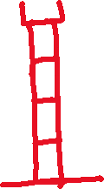










Get your robot
Use USB2Dyanmixel and PowerHub
Set servo max and min limits
Set center positions
Center positions are going to be your robot’s initial position for each servo
If I tell all the servos in your robot move to its center position, the robot must go to its initial position.
Test all servos

